Slide 1
Virtual Reality

Slide 2
Physical Computing
In the next set of lectures, we’re going to sample a set of HCI areas:
  Tangible UI
  Augmented Reality
  Wearables
  Ubicomp
They all try to widen the arena of discourse for computing, to use more of the physical world, via sensors.

Slide 3
Trend
Exponential growth in computer speed; Moore’s Law, but
Linear, stairstep growth in bandwidth and naturalness of our interaction with the computer

Slide 4
Arena of Discourse
Over time, we’ve seen an evolution in the use of computers along many dimensions. Let’s look at 3:
  Where are the computers located?
  How do users provide input?
  How is output provided?

Slide 5
Where are the computers located?
50s – huge computer room
60s – small computer room
70s-90s – desktop/laptop
Things seem to have stalled…

Slide 6
How do users provide input?
50s – flipping switches, typing to cards
60s – typing
70s-90s – typing, mousing
Things seem to have stalled…

Slide 7
How is output provided?
50s – blinking lights, tape, printers
60s – tape, printers, CRTs
70s-90s – printers, CRTs. Some sound, haptic
Things seem to have stalled…

Slide 8
In Sum
There is very little in a 2002 interface that would seem alien to a user of a PARC 1972 interface.
  “Windows 95 = Mac 84” too generous!
Why?
  Have we run out of new ideas?
  Do we declare victory and move on?
  Is it MSFT’s fault?

Slide 9
Breaking on through…
These new techniques try to break this logjam, in overlapping and complimentary ways.

Slide 10
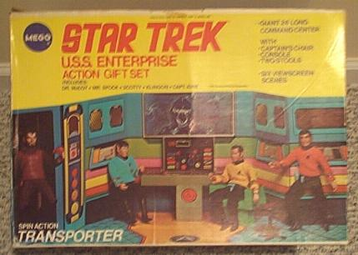
Ubicomp
Ubicomp – computers can be anywhere, and look like anything. They are ubiquitous
Upcoming lecture
Notes:
Picture showing Star Trek Bridge.

Slide 11
Digression
Ubicomp and Virtual Reality are philosophical opposites
  Virtual Reality – you are integrated into the computer’s world
  Ubicomp – the computer is integrated into your world
More on this later

Slide 12
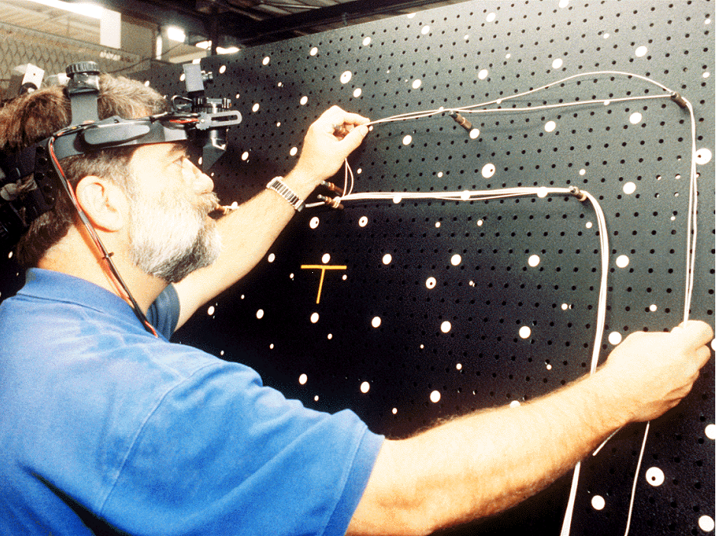
Augmented Reality
Enhancing what you see/hear as you move about
Upcoming lecture
Notes:
Picture of David Mizell of Boeing using an Augemented Reality system to connect wires on an airplane board.

Slide 13
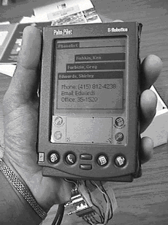
Tangible Interfaces
Enhancing physical objects, and your manipulations of them
This lecture!
Notes:
Picture of a Palm Pilot augmented to detect squeezing and tilting.

Slide 14
Where are the computers located?
70s-90s – desktop/laptop
00s
  On your body (Wearable)
  In the environment (Ubicomp)

Slide 15
How do users provide input?
70s-90s – typing, mousing
00s
  Audio, VR, etc.
  By manipulating physical objects (Tangible)

Slide 16
How is output provided?
70s-90s – printers, CRTs. Some sound
00s
  By enhancing what you see/hear as you move about (Augmented Reality)
  By altering physical objects (Tangible)

Slide 17
Tangible Interfaces
So, on to Tangible interfaces
Basic idea, again: to let users interact with physical objects. Three “traditional” ways:
  “Magic Desks” (Ishii)
  Augmented/reified objects (Want)
  Calm computing (Jerimijenko)

Slide 18
But Why?
Why is tangibility good?
  “The interactions with those GUIs are separated from the ordinary physical environment in which we live and interact”
  “The World is the interface”
    subset of Ubicomp
People already have physical objects, with learned connotations, affordances, metaphors
People can do many more gestures than typing and mousing
Lowers cognitive barriers.

Slide 19
More on Tangibility
Tends to use specialized, not “generic” widgets (keyboard, mouse).
Although can supplement, not replace, previous generic widgets.
Generic --- specialized tradeoff debate has been going on for decades.
Big need for user testing to help resolve this issue!

Slide 20
Proof is in the citing…
Ishii paper has been cited 158 times! ( http://citeseer.nj.nec.com/ishii97tangible.html )
Flood of follow-on work
  (BTW, some done at UW – DMG)

Slide 21
Parade of Examples
Many “fellow systems”, plus three of theirs. Demonstrate some of the possibilities for Tangible UI (TUI).

Slide 22
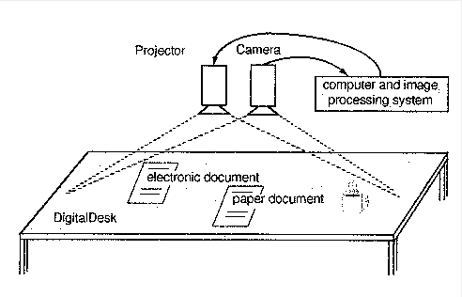
Digital Desk
Wellner, P., Mackay, W., and Gold, R. “Computer Augmented Environments: Back to the Real World”. CACM 36(7), July 1993.
“Magic Desk”. Use cameras to see where hands are, what documents are on top, etc.
Give feedback by projection system
Integrate with hands
  E.g. “where’d I put document X?”
  E.g. “print this”
A.R., not TUI
Notes:
Picutre of “digital desk”, cameras pointing at workspace.

Slide 23
Task: specifying a planar slice
The task: specify a plane in 3-space
That plane then slices through an MRI and displays the results.
How would you design this UI?

Slide 24
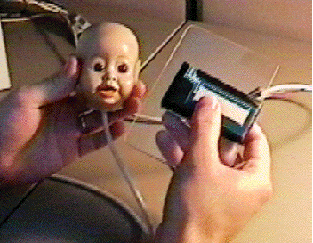
Hinckley Doll’s Head
Hinckley, K., Pausch, R., Gobble, J., Kassell, N., Passive real-world interface props for neurosurgical visualization. Proceedings of CHI'94. 1994. ACM. pp. 452-458
Early and great example of power of metaphor.
“So advanced, it’s simple”
Had actual users!
Tangible but not Ubicomp – system totally “tethered” to PC.
Notes:
Picture of user holding augmented “dolls head” in one hand, cutting plane glass in another.

Slide 25
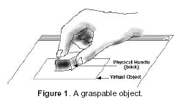
Bricks
Fitzmaurice, G., Ishii, H., and Buxton, W. “Bricks: Laying the Foundations for Graspable User Interfaces”, CHI ’95, p. 442-449.
TUI without any metaphor – closer to the “generic” side of the tradeoff
Notes:
Picture of user moving a black “Brick” about an augmented desktop.

Slide 26
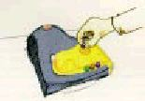
Marble Machine
Bishop, 1995. In Crampton Smith, G. “The Hand That Rocks the Cradle”, I.D., May/June 1995.
Reifies messages into marbles
Any relation to “Minority Report” purely intentional
Why is this cool? What have you gained?
Notes:
Picture of user picking up a “marble” from an augmented messaging machine.

Slide 27

Live Wire
Example of what has come to be called “calm computing”
Computer mediates/manages the appearance of some background physical object in a non-intrusive way
Notes:
Picture of a picture of elderly woman with butterflies around the margin showing state.

Slide 28

metaDesk
Merge GUI with “Digital Desk”
Make physical analogs of GUI instruments
Term “phicon” has come to refer to any such enhanced object

Slide 29
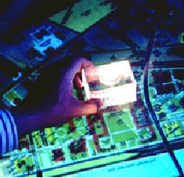
metaDesk: phicon
Take virtual icon and make it physical
Where icon means “I represent an object (noun) or action (verb)”
E.g. “show me where this building is”
Also used then as bricks-like widget
Notes:
Picture of a phicon being placed on a desk.

Slide 30
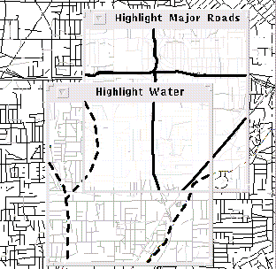
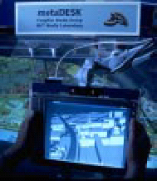
metaDesk: lens
Previous GUI work on “Magic Lenses”
  E.g. Stone, Fishkin, Bier, “The Movable Filter as a User Interface Tool”, CHI ’94.
Take virtual lens and make it physical
Notes:
Picture of desktop “magic lenses” system in action next to MIT “physical lens”.

Slide 31
metaDesk: ambientRoom
Examples of “calm computing”
web activity levels mapped to rain sounds
web activity levels mapped to water ripples
Many, many more done in later years

Slide 32
metaDesk: transBoard
Think back to “answering machine marbles”
By reifying virtual objects, we can carry and move them. Translating back and forth between physical and virtual.
tends to be called “pick and drop”, after Rekimoto (UIST ’97)

Slide 33
Want paper
Similar emphasis to Ishii paper, on tangible objects and their manipulations
Differs:
  Emphasis on tagging existing everyday objects, which already have connotations
  Explores compound sequences, and context (gesture “language”).
  Emphasis on lightweight, portable systems
  Not vision-based

Slide 34
Overlaps
Wearable/A.R.
  smart eyeglasses
Wearable without A.R.
  Pager, twiddler, touchType
A.R. without Wearable
  soundscapes

Slide 35
Overlaps
Ubicomp/Tangible
  tagged objects
Ubicomp without Tangible
  Context sensing
  Star trek doors
Tangible without Ubicomp
  Doll’s head

Slide 36
Overlaps
Tangible/A.R.
  calm computing
  (whole ‘nother lecture)
Tangible without A.R.
  “Smart Photo Cube”
A.R. without Tangible
  smart eyeglasses, “smart poster”, digital desk

Slide 37
Overlaps
Which is: these are similar techniques “at heart”, with different emphases
  Ubicomp – the computers are scattered about
  Wearable – you are wearing the computer
  A.R. – computer is enhancing your journey
  Tangible – computer is enhancing objects

Slide 38
Since then….
Many, many papers exploring this space
  Also emphasis on expanding vocabulary of gestures, not just of objects
But few user studies or deeper exploration

Slide 39
Project
The TUI emphasis on physicality emphasizes touch and gesture. This seems like it might be a good match for UI for the blind, as discussed in a previous lecture. Investigate a TUI interface tailored for the blind.

Slide 40
Readings for Next Time
Anthony Webster, Steven Feiner, Blair MacIntyre, William Massie, Theodore Krueger. “Augmented Reality in Architectural Construction, Inspection, and Renovation”. Proc. ASCE Third Congress on Computing in Civil Engineering, Anaheim, CA, June 17-19, 1996, 913-919. Available at http://www.cs.columbia.edu/graphics/publications/asceLOW-RES.pdf

Slide 41
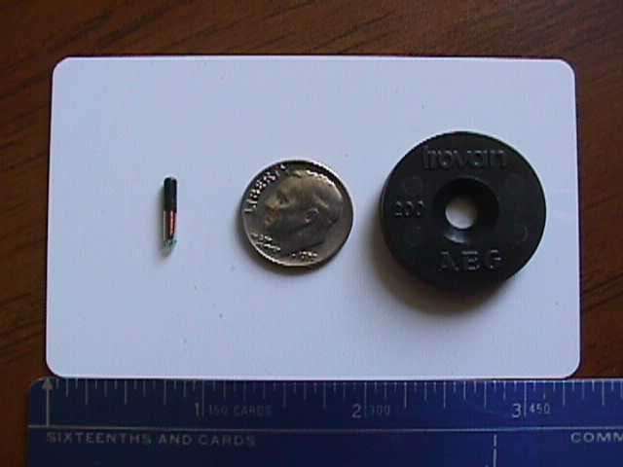
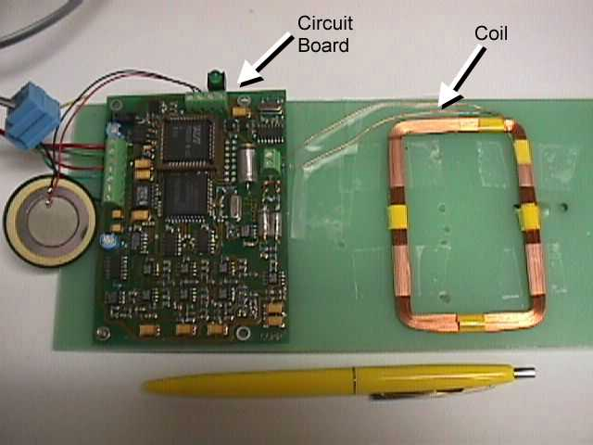
Wireless Tagging Technology
Trovan radio frequency passive ID tags
Powered by reader - no battery
4 different size/range tag readers
range (version 1) - up to 12 cm
Many (40 typical) bits of unique ID (550 billion)

Slide 42
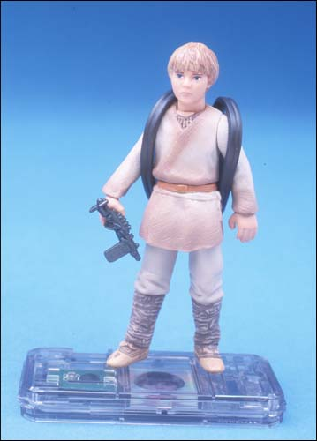
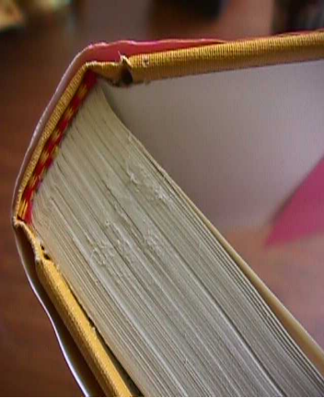
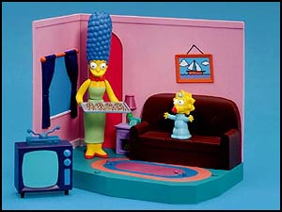
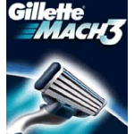
RF tags are nice because…
Ubiquitous and Flexible

Slide 43
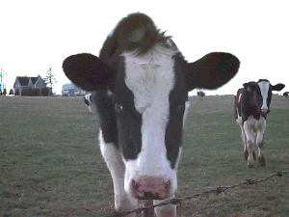
Robust, no line of sight

Slide 44
Tags are getting better
Much energy/interest from industry
Main focus is tagging/tracking packages
  FedEx, UPS
  Airline baggage
  Inventory/warehouse management
    E.g. US Army, Gillette, Libraries

